Slide 2
Cystadleuaeth Genedlaethol ar gyfer Ysgolion Cynradd /A National Competition for Primary Schools
Nod:
Meithrin sgiliau menter ymhlith plant mewn ffordd fywiog a difyr.
Mae’n cefnogi datblygiad sgiliau rhifedd a llythrennedd
Tîm o gymeriadau arwrol wedi’i seilio ar y sgiliau a’r ymddygiad sydd eu hangen i fod yn entrepreneuraidd – Amy, Callum, Rhian ac Owain
Rhan o ymgyrch Syniadau Mawr Cymru Llywodraeth Cymru i gefnogi pobl ifanc yng Nghymru rhwng 5 a 25 oed i fod yn fwy entrepreneuraidd.
Aim:
To develop entrepreneurial skills in children in a lively and enjoyable way.
It supports numeracy & literacy skills development.
A team of superhero characters based on the skills & behaviours needed to be entrepreneurial – Amy, Callum, Rhian & Owain.
Part of Welsh Government Big Ideas Wales campaign to support young people in Wales between the age of 5-25 to become more entrepreneurial.

Slide 3
Cystadleuaeth Genedlaethol ar gyfer Ysgolion Cynradd/A National Competition for Primary Schools
Beth sydd angen ei wneud:
Cael timau o’ch ysgol yn datblygu syniad busnes a’i roi ar waith (unrhyw fenter a ddechreuwyd o Ionawr 2015)
2 gategori:
Cyfnod Sylfaen
CA2
(Gallu cystadlu yn y ddau gategori)
Manylion cofrestru a chyflwyno cais, ac adnoddau defnyddiol i’w cael ar wefan Y Criw Mentrus:
www.ycriwmentrus.com
What do we need to do:
It asks for teams from your school develop & implement a business idea (any enterprise started from January 2015).
2 categories:
Foundation Phase
KS2
(Can compete in both categories)
Registration and application process details and useful resources available on the enterprise Troopers website:
www.enterprisetroopers.com

Slide 4
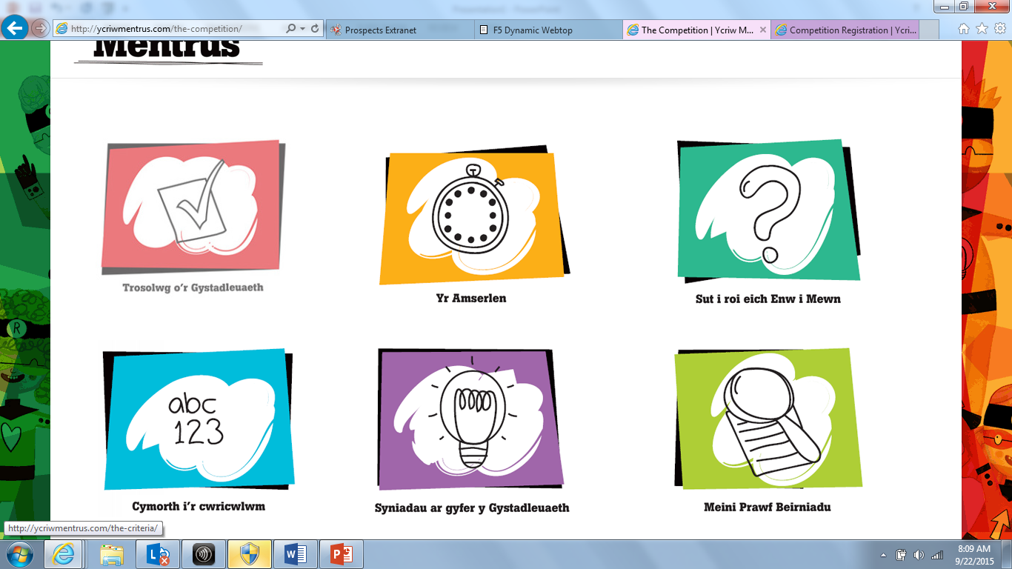

Slide 5
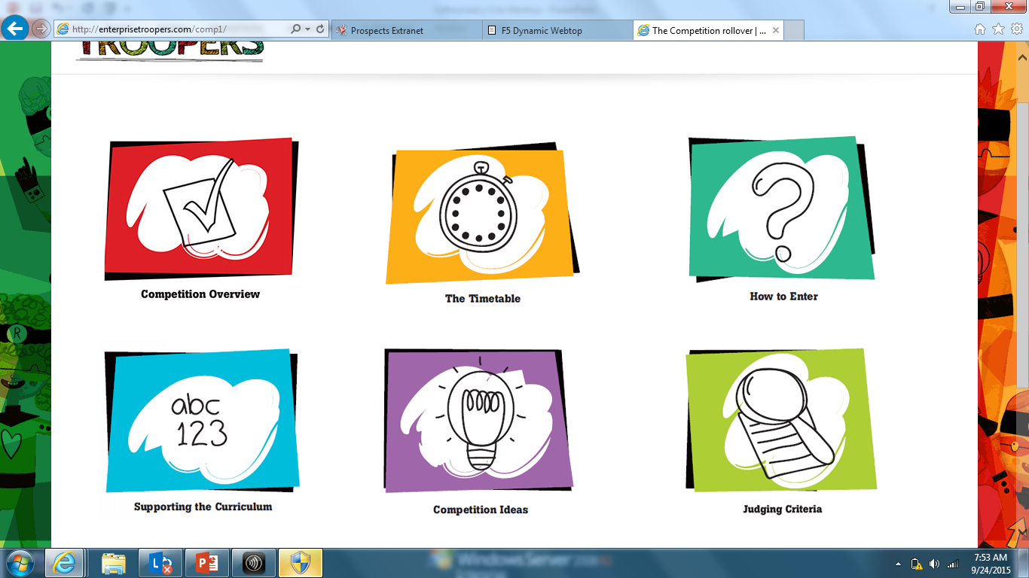

Slide 6
Cystadleuaeth Genedlaethol ar gyfer Ysgolion Cynradd/A National Competition for Primary Schools
Camau ac Amserlen:
Cofrestru cais (cyn gynted â phosib)
Cam 1: Cyflwyno cais (cyn Ionawr 14, 2016) Gwobr Efydd
Cam 2: Rownd Derfynol Ranbarthol (Chwefror 2016) Gwobr Arian
Cam 3: Rownd Derfynol Genedlaethol Cymru (Mawrth 2016) Gwobr Aur
Gwobr Platinwm i enillwyr yn y rownd derfynol
Gwobrau – Ysbryd Tîm, Stondin arddangos, Cysylltu efo busnes, Seren y Criw, Pencampwr yr Athrawon, Enillwyr rhanbarthol/cenedlaethol, Ail orau, Cyflwyniad gorau.
Stages & Timetable:
Register your application (asap)
Stage 1: Entry submission (by January 14, 2016) Bronze Award
Stage 2: Regional Finals (February 2016) Silver Award
Stage 3: Welsh National Final (March 2016) Gold Award
Platinum Award for the winners in the national final
Awards – Team Spirit, Display stand, Business Engagement, Star Trooper, Regional/National winners & runners up, Best presentation, Teacher Award

Slide 7
Cystadleuaeth Genedlaethol ar gyfer Ysgolion Cynradd / A National Competition for Primary Schools
Enwau cyswllt lleol / Local contacts:
Ann Llwyd:
ann.llwyd@cazbah.biz
Delyth Rowlands:
delyth.rowlands@prospects.co.uk

Slide 8
Cystadleuaeth Genedlaethol ar gyfer Ysgolion Cynradd / A National Competition for Primary Schools
Beth am roi cynnig arni yn 2015?
Give it a go in 2015!

