Slide 1
School Governors Wales
E-learning site

Slide 2
Introduction
Gareth Cadwaladr
Head of Web Developments at CYNNAL
CYNNAL:
moodle support/administration for schools
Develop e-learning resources
Data analysis for schools / LAs
On-line management tools (questionnaires / self evaluation framework)
Support ICT / Networks in schools
Manage and support MIS systems in schools

Slide 3
Background
Create an on-line tool that supplements or offers an alternative to face-to-face governor training if needed.
Bilingual
Login system with different user accounts
Differentiate between governors and GSOs
Track governor progress

Slide 4
Background (…continued)
4 Courses initially:
Understanding data (Primary, Secondary, Special)
Chairs Training
Clerk Training
Governor Induction
... With the facility to add more courses in the future if needed.

Slide 5
e-learning-governors-in-wales.org.uk
Based on moodle – an open source virtual learning environment.
Bilingual
Separate user accounts
Different levels of access
Track user progress
Test users’ understanding
Users can receive certificates

Slide 6
e-learning-governors-in-wales.org.uk
Workflow

Slide 7
Workflow
Governor requests access from GSO
GSO enters governor details into template.
GSO e-mails the spreadsheet to CYNNAL
CYNNAL creates user accounts and returns login details to GSO
GSO delivers login credentials to Governor.
Governor logs into the site and completes the courses.
GSO can then download reports on user completion.

Slide 8
e-learning-governors-in-wales.org.uk
Governor Walkthrough

Slide 9
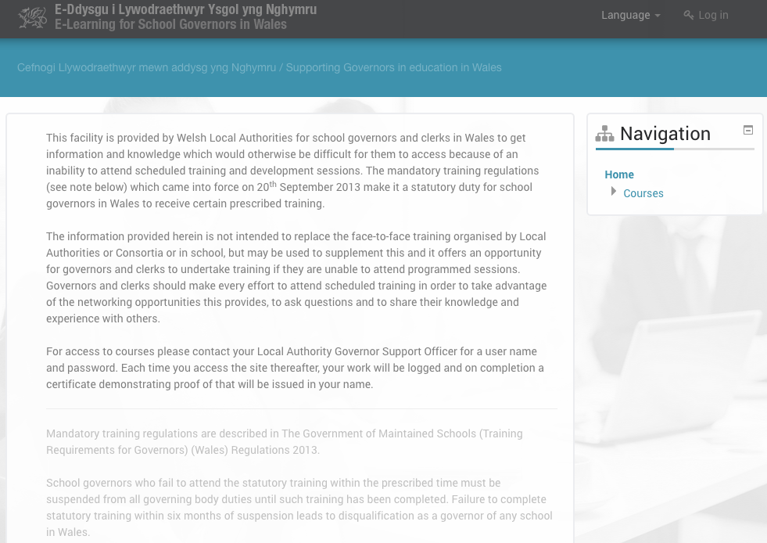

Slide 10
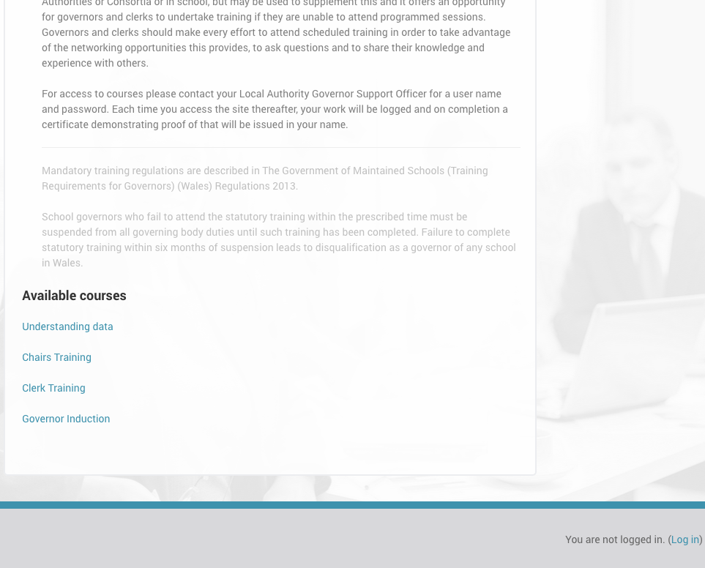

Slide 11
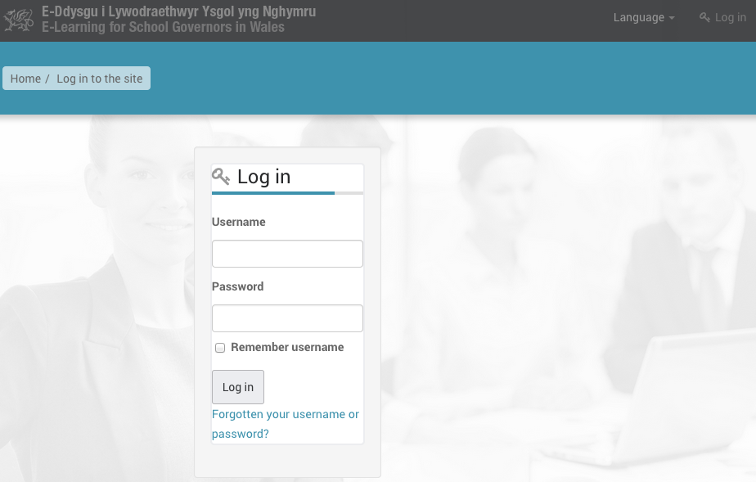

Slide 12
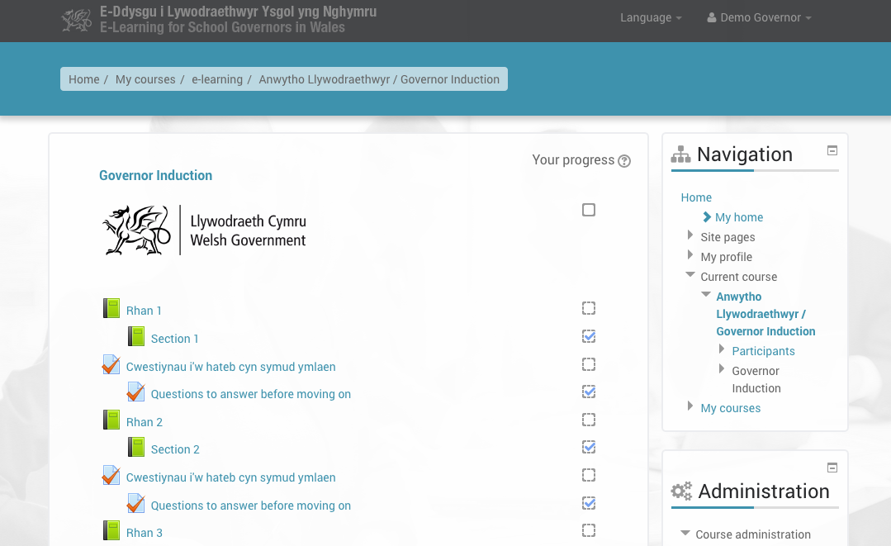

Slide 13
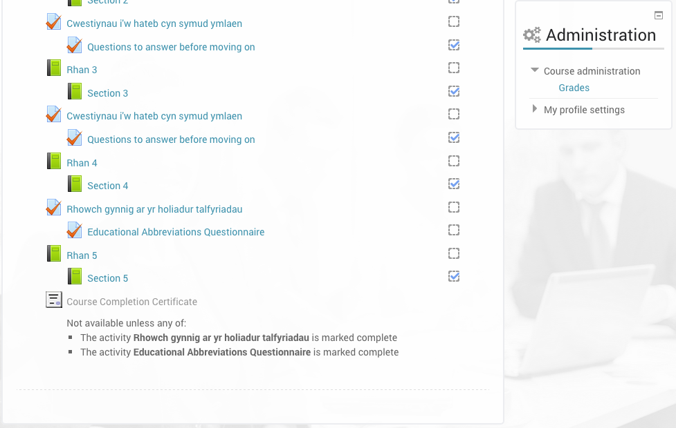

Slide 14
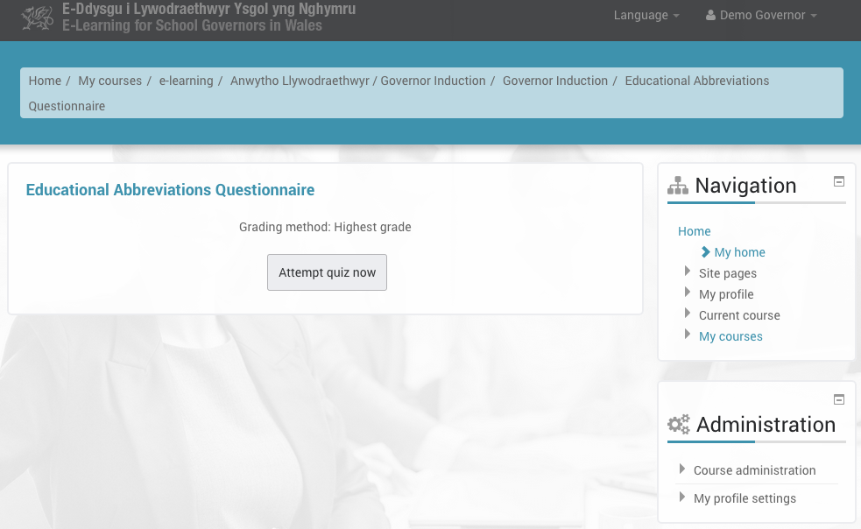

Slide 15
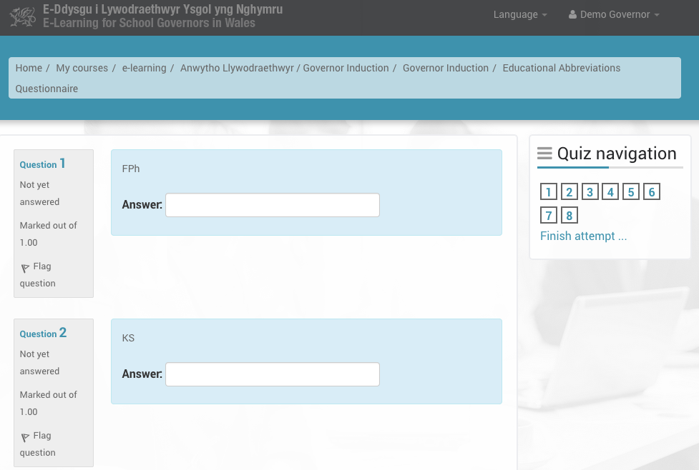

Slide 17
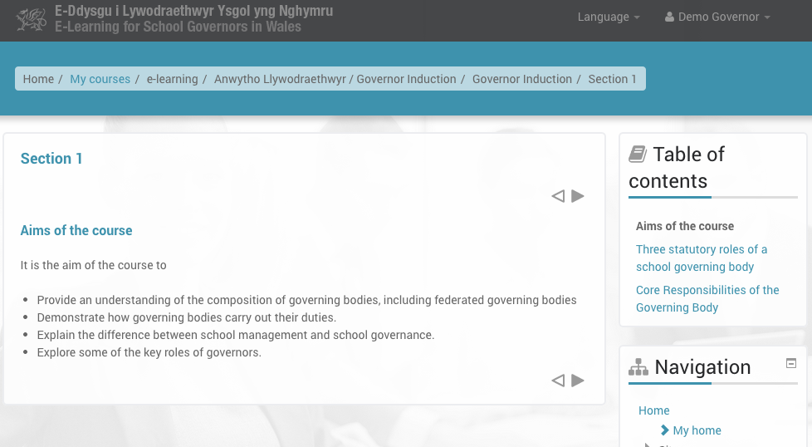

Slide 18
e-learning-governors-in-wales.org.uk
GSO Walkthrough

Slide 19
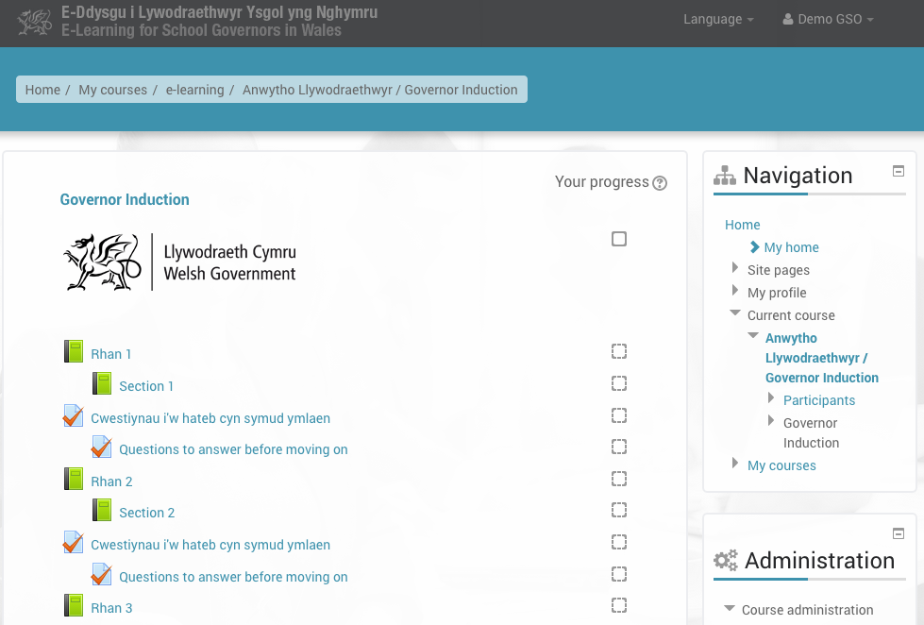

Slide 20
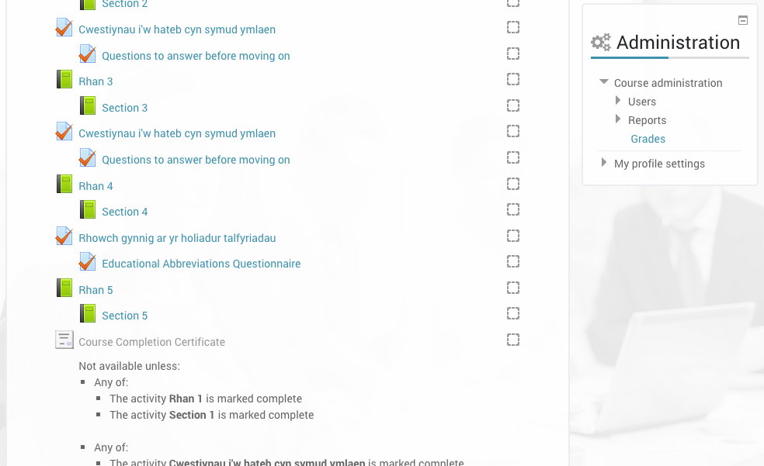

Slide 21
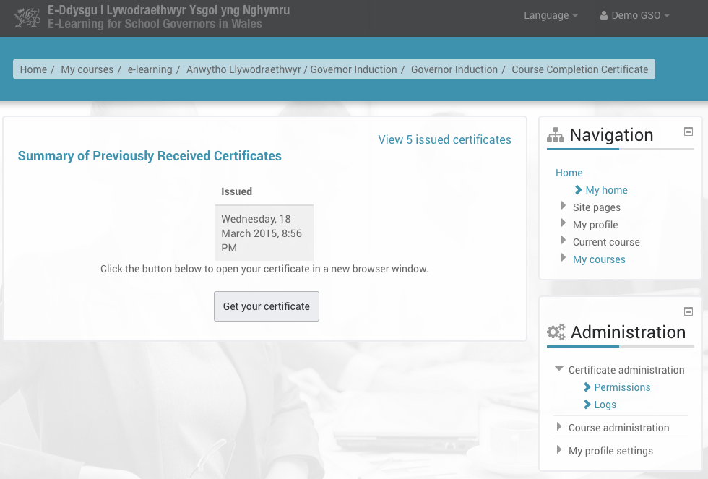

Slide 22
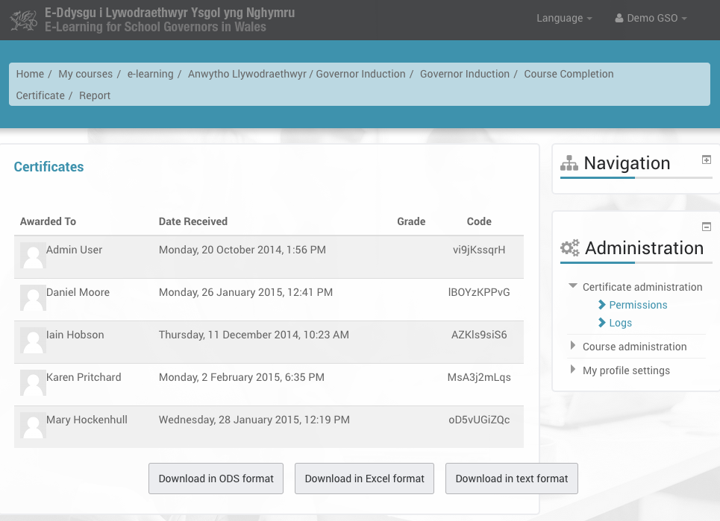

Slide 23
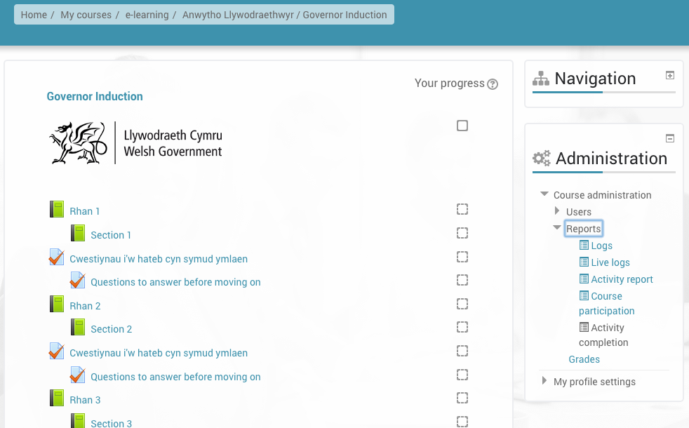

Slide 24
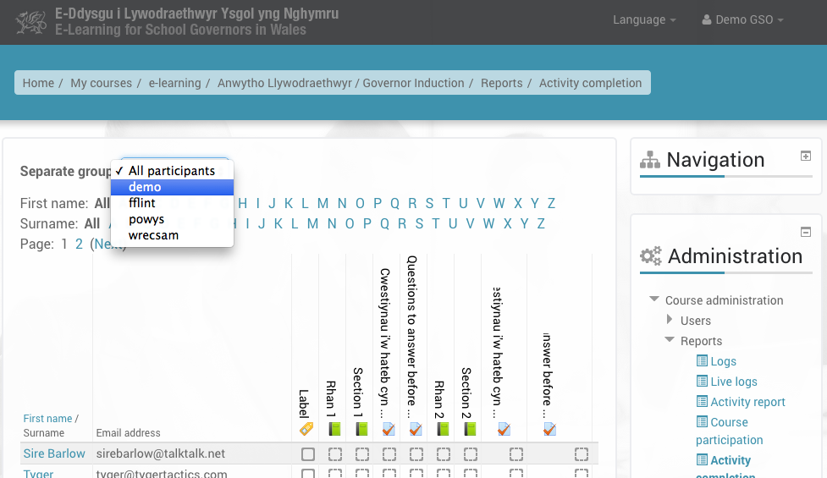

Slide 25
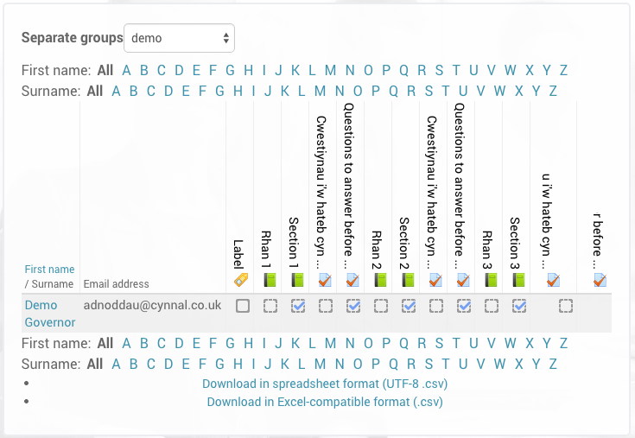

Slide 26
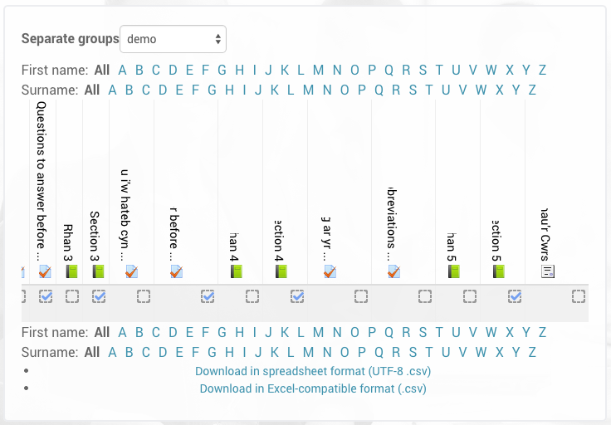

Slide 27
Diolch
Gareth Cadwaladr

